Slide 1





Smart contract development with solidity
Basics of contracts
Smart Contract Development with Solidity
SoftUni Team
Technical Trainers
Software University
http://softuni.bg
Logos: https://www.ethereum.org/assets

Slide 2

Table of Contents
The address data type
Solidity globally available variables
Events
Access modifiers
Function modifiers
pure, view, payable
Custom modifiers
Solidity exceptions
How to throw them

Slide 3
Questions
sli.do #SContracts

Slide 4
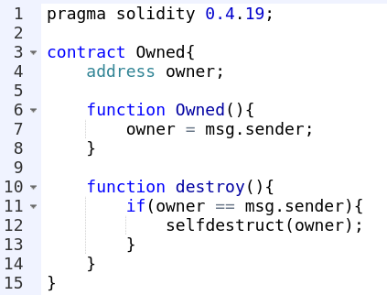
The address type
Holds a 20 byte value (size of an Ethereum address).
Has members.

Slide 5
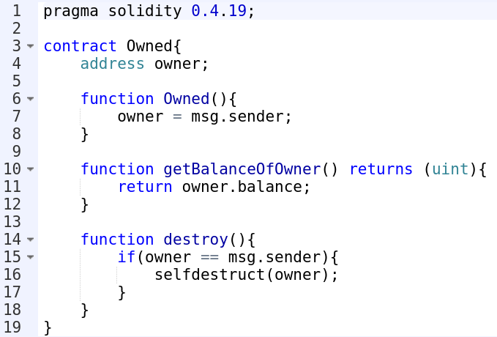
Address members
balance
transfer(uint amountInWei)
call, callcode, delegatecall (discuss in the following lectures)

Slide 6
Units and globally available values (1/2)
block.gaslimit (uint): current block gaslimit
block.number (uint): current block number
block.timestamp (uint): current block timestamp as seconds since unix epoch
msg.gas (uint): remaining gas
msg.sender (address): sender of the message (current call)
msg.value (uint): number of wei sent with the message
now (uint): same as block.timestamp

Slide 7
Units and globally available values (2/2)
Time units:
1 == 1 seconds
1 minutes == 60 seconds
1 hours == 60 minutes
1 days == 24 hours
1 weeks == 7 days
1 years == 365 days
Value units:
1 == 1 wei
2 ether == 2000 finney
...

Slide 8
Exercise:
Write a contract, that:
Holds a uint state variable (value passed in constructor)
Has a function to increment that value by one, if:
The caller is the owner of the contract
At least 15 seconds have passed since the last increment

Slide 9
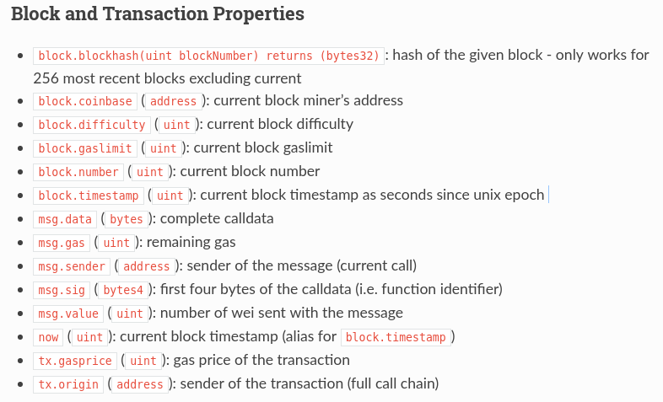
Read more:
http://solidity.readthedocs.io/en/develop/units-and-global-variables.html

Slide 10
Contract events (1/2)
A log, submitted by a contract, that stays on the blockchain
The blockchain can be easily filtered for events made by contracts
Used to track contract actions
The ERC20 standard uses events

Slide 11
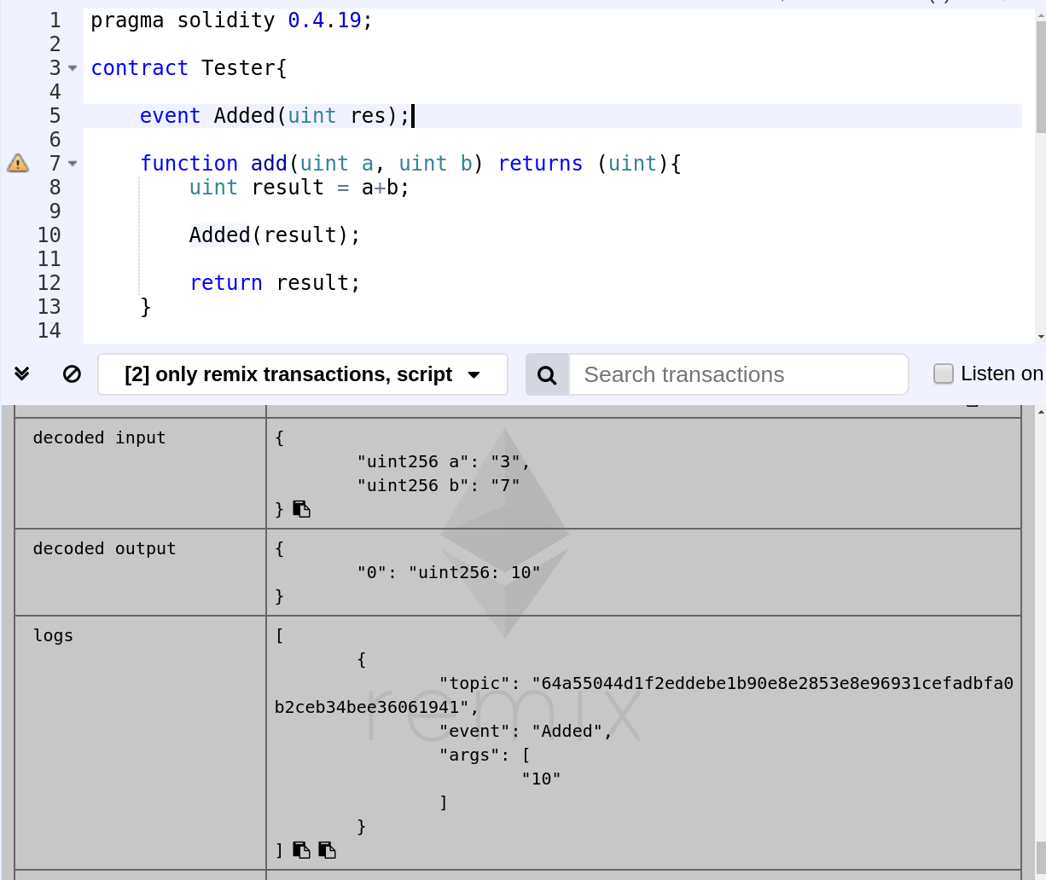

Slide 12
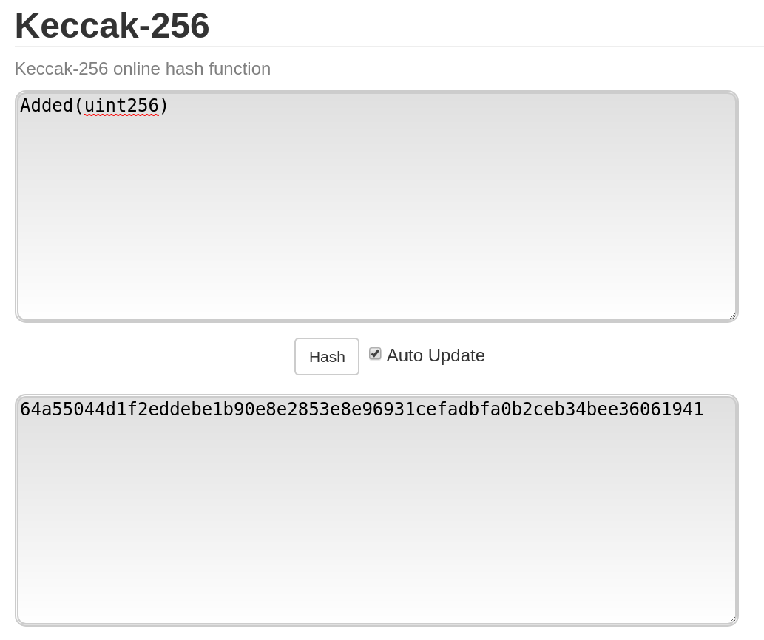
Event topics

Slide 13
Contract events (2/2)
Arguments can have the indexed keyword
The blockchain can be filtered by also certain values of an indexed argument

Slide 14
Exercise:
Write a contract, that:
Knows its owner (contract publisher)
Has a method that changes the owner
Can only be called by the current owner
The method takes one argument - address of the new owner
At each owner change, a contract event is created with two fields - the old and new owner

Slide 15
Function visibility
external - can only be called via a transaction and not within the contract
public - can be called both externally and internally
internal - can only be called within the contract or contracts deriving from the contract
private - can only be called within the contract where defined
Compiler complains if you don’t specify the visibility

Slide 16
State variables visibility
public - an automatic getter function is generated
internal - accessed from the contract or driving from it
private - accessed only from the contract
The access modifiers only restrict what other contracts can do with our contract.
Everything on the blockchain is public and any node knows the values of any private variables

Slide 17
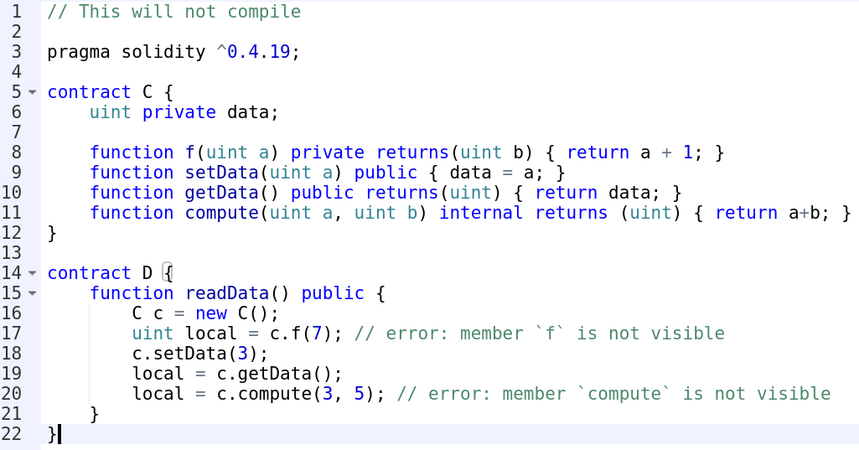

Slide 18
Function modifiers
view - should be used in functions that do not change contract state
pure - should be used in functions that do not access the state in the first place
We can call view or pure functions free of charge. Whatever doesn’t change state, doesn’t cost or has a gas limit !
payable - function that can receive ether (which is sent to the contract address)

Slide 19
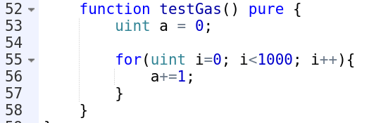

Slide 20
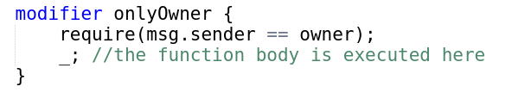
Custom modifiers
Code that is called before a function body is executed. Usually to check whether the function can be executed.
Can be reused for multiple functions

Slide 21
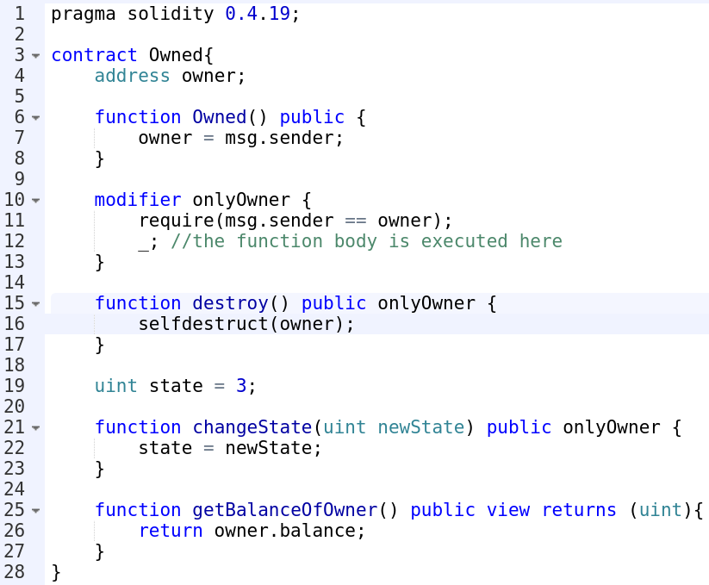

Slide 22
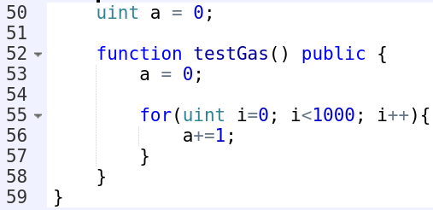
Ethereum exceptions
Out of gas exception
That’s it. It is thrown in all failing cases (example modulo or divide by zero)
Cannot be caught
The transaction is reverted as are all blockchain changes
This will blow up ^

Slide 23
Throwing exceptions
assert() - should be used to check internal errors (unexpected / bug behavior)
require() - should be used to check valid conditions (input or state variables)
revert() - flag an error (similiar to assert)

Slide 24
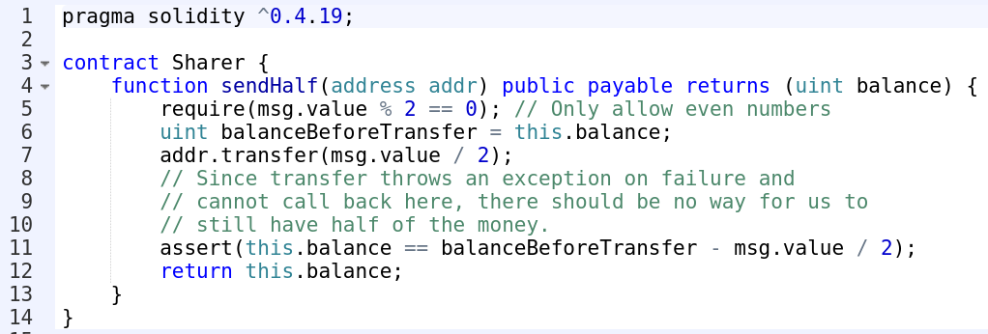

Slide 25
The fallback function
Every contract that receives ETH payments WITHOUT a function call MUST implement a fallback function
The function is called if a nonexistent contract function is called, or no contract function is called at all (just ETH pay)
The function must be payable for the contract to receive plain ETH (no code execution)
Only 2300 gas allowed in the function!

Slide 26
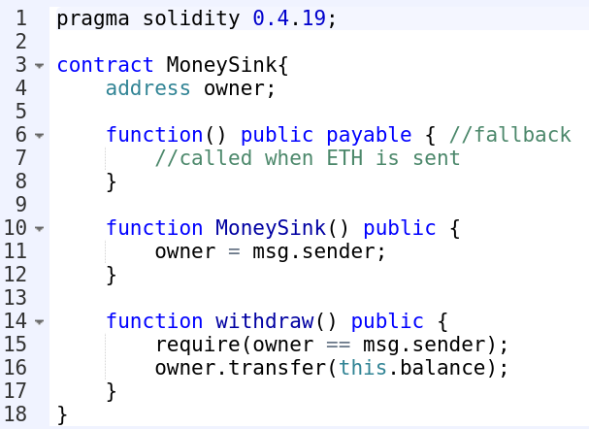

Slide 27
Exercise:
Create a faucet contract, that:
Is owned
Can receive plain ETH payments from anyone
Has method to get its balance
Has a state variable sendAmount with initial value 1 ETH
The value of sendAmount can be changed by the owner
Has method to withdraw sendAmount of money for free, publicly (if available)
Has method to send sendAmount of money to someone else for free
The owner can withdraw as much as he wants
Use assert and require to assure that ETH can be withdrawn
Creates an event for every withdrawal
Can be destroyed by the owner
Use custom modifiers to check if money can be withdrawn

Slide 28
Homework:
Create a contract, that:
Has a method to buy a certain service. The service costs 1 ETH.
If the money sent are more than 1ETH, the contract will return the extra back.
The contract confirms that the person bought the service by emitting an event.
Nobody can buy the service for 2 minutes after someone bought it. Use a custom function modifier for that.
Use assert and require whenever possible.
The owner of the contract can withdraw the money once per hour and maximum of 5 ETH at a time.

Slide 29
Summary
The address type and its methods
Ether, time units and globally available variables
Contract events
Function and variable visibility
Function modifiers and free functions
Custom modifiers
How to handle error cases
How to transfer money using contracts

Slide 30







https://softuni.bg/courses/

